Slide 1
State of State Exchanges
Health TechNet Meeting
April 25, 2014

Slide 2

Strategic Context
A confluence of health market trends have led to the emergence of Health Insurance Exchanges.
PPACA
Health Cost Inflation
Public Exchanges
Affordability Concerns
Private Exchanges
Path to Defined Contribution
Commercial Sponsorship
Consumer-Directed Benefits
Health Insurance Exchanges
“Marketplace” Technology
“Retail” Expectations
Online Brokers
Consumerism

Slide 3
Public vs. Private Exchanges
Although often spoken-of jointly, the Private Exchange is quite different from its Public sibling.
Public Exchange
Private Exchange
Provide affordable coverage | Reduce employer cost Expand employee choice and flexibility
States State Based Exchange (SBE) Federal Partnership Federally Facilitated Exchange (FFE) | Health Plans Broker / Benefits Consultants PE Vendors Large Employers
Subsidized Individuals Small Businesses | Post-65 Group Retirees Active Employees and pre-65 Retirees Associations Individuals
Value
Proposition
Sponsors
Target
Market

Slide 4
What is a Private Exchange?
A Private Exchange is an online marketplace where group members (e.g., employees) or individuals can shop for benefits, often with a defined contribution.
Two converging trends have led the industry to the private exchange solution…
  Employers are challenged by affordability of health insurance
  Employees prefer a retail-like experience and more choice
Employee Impact
Employer Impact
Private exchanges represent a fundamental market shift, empowering individual employees to be the decision makers.
Private exchanges allow employers to minimize their role in benefits management and control costs by shifting financial accountability to employees.

Slide 5
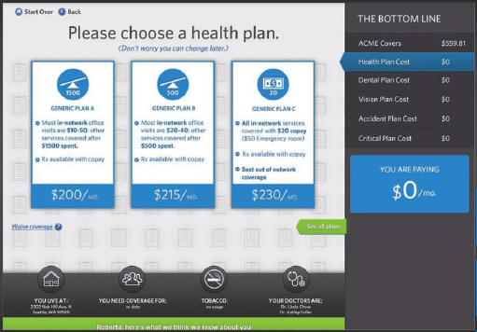
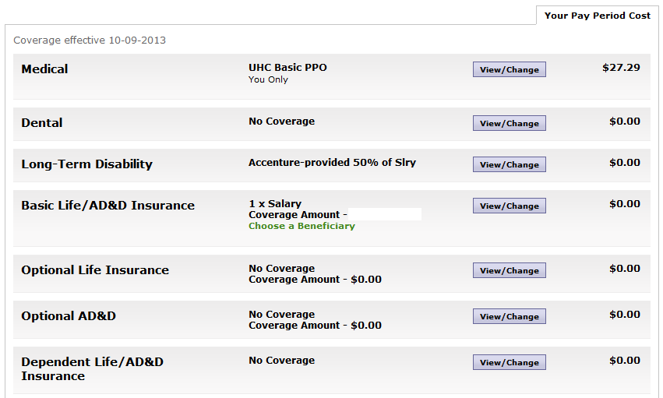
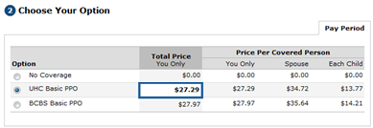


Private Exchanges at a Glance
Private Exchanges offer a retail-like, online shopping experience and will become the “Amazon.com of healthcare” that meets digital demand.
Traditional benefits portals provide an enrollment workflow with limited choice, an experience analogous to filling out a form at the doctor’s office.
Private Exchanges provide an intuitive shopping experience with support for defined contribution, product bundling, decision support, and more.
User
Experience:
User
Experience:

Slide 6

Public Exchange Models
There are 3 types of public exchanges, the most common for 2014 being the Federally Facilitated Marketplace (FFM)
Exchange Model Continuum
State Based
Partnership
Federal
State owns and operates core functions:
Plan Management
Eligibility & Enrollment
Financial Management
Consumer Assistance
States may use federal government services for:
Premium Tax Credit & Cost Sharing Reduction
Risk adjustment program
Reinsurance Program
State operates activities for:
Plan Management
Consumer Assistance
Both
States may elect to perform or can use federal government services for the following activities:
Reinsurance Program
Medicaid and CHIP eligibility assessment or determination
HHS operates; however, State may elect to perform or can use federal government services for the following activities:
Reinsurance Program
Medicaid and CHIP eligibility assessment or determination
Notes:
States either set up HIX or participate in FFM, with goal of all states setting up own HIX (DC circuit argument that FFM cannot authorize tax credits) or participating in multi-state HIX.

Slide 7


HIX Context
KEY
17 | State Based Marketplace
7 | State Partnership Marketplace
27 | Federally-Facilitated Marketplace
 | Accenture HIX Clients
 | Experiencing Challenges
 | Moving to SBM By 2016
 | Considering Multi-State Model
7
2
7
1

Slide 8
The State Base Marketplace (SBM) Scope Spectrum
States are approaching SBMs in a variety of ways, which directly impacts the cost to serve.
Full-Service
MMIS integration – Multichannel Service Model - Automated workflow, Geo Targeting – Risk Management - Standardized Operational Processes Advanced Data Privacy - Payroll Integration
Enhanced
Common Data Validation - Plan Recommendations, Location Based Mapping
Cost to Serve
PPACA Compliant
Toll free hotline, info-rich website, pricing and benefits, plan eligibility
Pre-HIX
Disparate data, paper based enrollment
Scope of Services

Slide 9
Key State Policy Decisions
Decision making groups should answer a set of key policy questions.
Key Exchange Issue | Threshold Questions
Structure and Administration | Governance model Merged or separate individual and SHOP exchanges | Statewide, regional, or multi-state Branding – distinct from other public programs?
Choices Affecting Product Design | Exchange as Active Purchaser or Market Organizer Separate or merged individual and small group markets Method for selecting and rating Qualified Health Plans | Potential state mandated benefits beyond the essential benefits Level of standardization for benefit designs Mandates to improve quality and efficiency of care delivery Combined purchasing and dual eligibilities
Operations | Degree of operational integration between individual and SHOP Degree of integration with other state programs | Internally or externally operated risk programs
Sustainability | Payer/Provider Assessment Ancillary services/products sold via Exchange marketplace | Leverage existing assets wherever possible General Revenues Premium tax

Slide 10
Key Consideration Categories
State Exchange issues and considerations can be categorized into 3 distinct categories.
Governance
$
Operations
Financial
Notes:
States either set up HIX or participate in FFM, with goal of all states setting up own HIX (DC circuit argument that FFM cannot authorize tax credits) or participating in multi-state HIX.
Define each category (best practices)
State governance

Slide 11
Federal Funding Timeline - Establishment
May 15 2014
Oct 15 2014
Jan 1 2015: No Section 1331(a) funding may be awarded after this date; Marketplace must be self-sustaining (implications for user fees); NCEs available for funding spend down up to five years after funding award date.
Dec 1 2019: Last day to spend down any Exchange Establishment Grant funding awarded Dec 1 2014, remaining under no-cost extensions.
Nov 15 2013
Aug 15 2014
Feb 14 2014
October 2013
January 2014
January 2015
January 2016
December 2019
Present: 90/10 & 50/50 funding exception available
Jan 1 2014
Jul 1 2014
Dec 31 2015: 90/10 & 50/50 funding exception ends
Dec 1 2014
April 1 2014
Oct 1 2014
KEY
Marketplace Funding
Medicaid Funding
Level One and Level Two Exchange Establishment Application Due
Anticipated Notice of Award for Prior Application Deadline for Level One and Level Two Exchange Establishment Grant
Last date to use federal Exchange Establishment Grant funding if any remains via No Cost Extensions
90/10 Funding & 50/50 Funding Exception
http://www.cms.gov/CCIIO/Resources/Funding-Opportunities/Downloads/amended-spring-2012-establishment-foa.pdf

Slide 12
HIX Consulting Experience
Operating Model Assessment
Financial sustainability strategy
1. California
3. Idaho
5. Massachusetts
Customer service operations advising
Financial Management
7. DC
Complete Exchange Solution
Service Center build out
Exchange Phase 1 Solution analysis and design support
Complete HIX Op Model
Business and technical requirements
Level 1 Grant assistance
Policy Analysis
IV&V and program design
Federal Government
IRS ACA strategy
Complete HIX
Operational model
Business and technical requirements and RFP
Level 1 Grant
2. Hawaii
4. North Carolina
6. Kentucky
BPR Transformation
of field offices
SHOP analysis and PMO
HIX Standard Operation Procedures
Functional Design
Operational Readiness
Change Management
Strategic Advisor
Systems Implementation
5
Existing Client
3
7
17 | SBM
7 | State Partnership Marketplace
27 | FFM
1
6
4
2

Slide 13

Thank You
Suniti Ponkshe
800 N Glebe Road
Arlington, VA 22203
Phone: 703-966-6689
Suniti.ponkshe@accenture.com

