Slide 1




Making Care Visible

Slide 2

We craft automation and performance improvement solutions for the world by turning the physical to digital.
July 2015

Slide 3
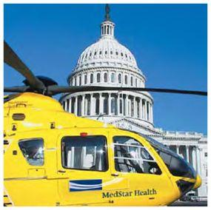
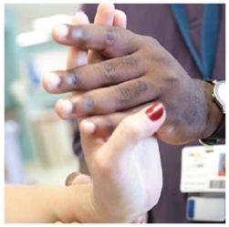
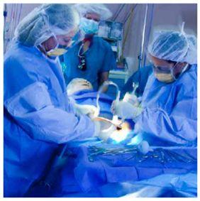
MedStar Health Vision
The trusted leader in caring for
people and advancing health.

Slide 4
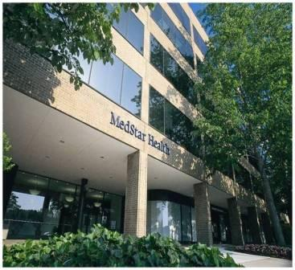
MedStar At-A-Glance
Ten hospitals and 20+ diversified companies
More than 100 locations across Maryland and DC
26,000+ associates
5,300 affiliated physicians
  1,100 residents/fellows in 80+ teaching programs
3,300 total licensed beds

Slide 5
MedStar Institute for Innovation
Serves as a catalyst for innovation across the MedStar organization
Created based on three foundational premises:
  For MedStar to achieve greatness in a changing and challenging healthcare environment, it must innovate.
  The tyranny of the daily trumps the pursuit of the remarkable unless consciously countered by a force and effort.
  A vast amount of untapped intellectual capital exists among MedStar’s 26,000+ Associates.

Slide 6

Introduction to zebra
$6B
GLOBAL
Market Cap
Leader in auto-id technology
Location & Motion experts in
REINVIGORATING
RFID
HEALTH

Slide 7
BRINGING INDUSTRY EXPERTISE TO HEALTHCARE
MOTION
RTLS
CURRENT GOLD sTANDArD IN MARKETPLACE FOR OPTIMIZATION
THE FUTURE, USING patterns of Motion to further INCREASE VALUE
PASSIVE RFID
BAR
CODES
TRACKING ASSETS TO REDUCE COSTS
IMPROVING safety, ACCURACY AND EFFICIENCIES FOR PATIENTS

Slide 8




CONVERGING MEGATRENDS
Internet of Things
Proliferation of connected devices / sensors
Explosion of data - “what is it, where is it, how is it doing?”
Expand beyond current focus / leadership in barcode and RFID
Wearable sensors
Convergence of mega-trends enabling real-time
Visibility
Insights
Actions
Cloud Technology
Ubiquity of cloud computing / apps enabling real-time data-driven insights
Build upon emerging leadership (e.g., Zatar, RhoMobile, LinkOS)
Mobility
Access to real-time info anytime, anywhere
Ability to interact with users and influence / drive their actions in real-time
Leverage market leadership in rugged / semi-rugged enterprise mobile devices

Slide 9
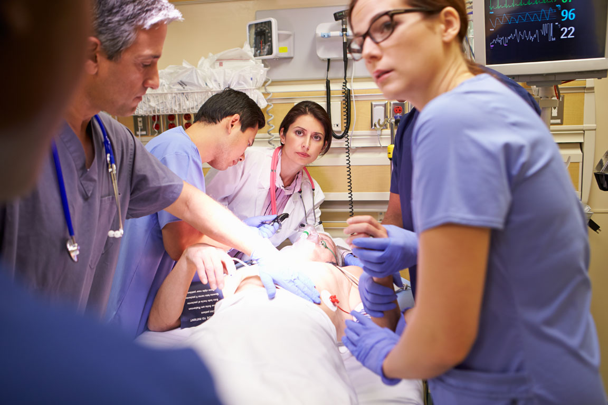
  WHAT IF YOU KNEW THE FUTURE BEFORE IT ARRIVED?
  UNDERSTANDING THE PATTERNS TO KNOW WHAT IS COMING NEXT
            Predictive Analytics from MotionWorksTM

Slide 10
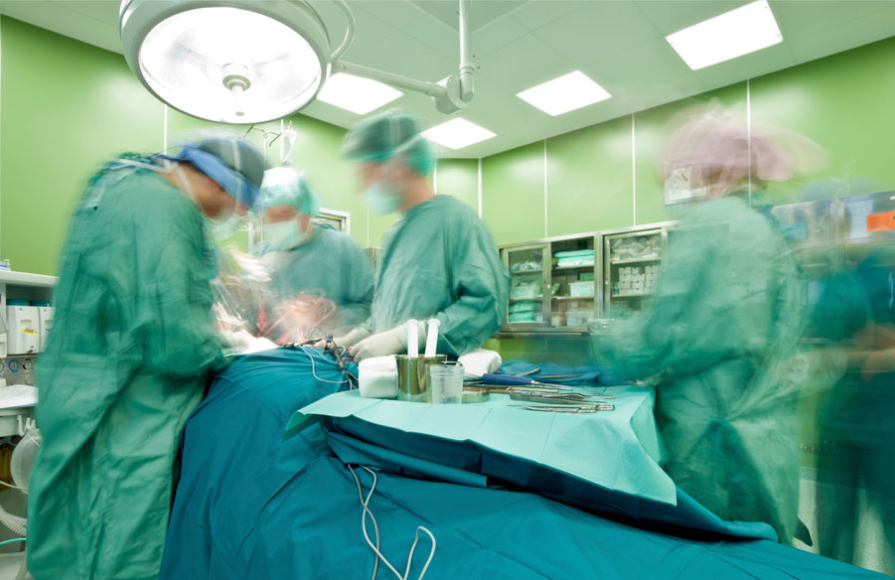
  WHAT IF YOU CATCH A PROBLEM BEFORE IT BECOMES ONE?
  USING MOTIONWORKSTM TO IMPROVE QUALITY THROUGH PREDICTIVE ANALYTICS
Notes:
NOTES

Slide 11
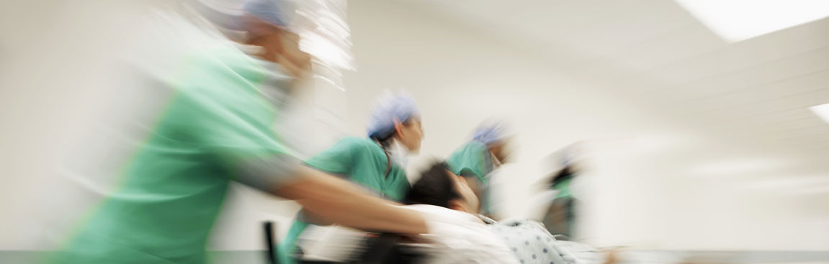
MotionworksTM as differentiator in healthcare delivery
Pattern Recognition
is well established in
medical diagnostics
Identify Patterns of Motion
correlated with
optimal outcomes
Isolate Key Variables
to extract even more efficiency/ quality out of patient care processes
Notes:
NOTES:
SCRIPT:
Pattern Recognition is well established in medical diagnostics
Similarly, identify patterns of motion correlated with optimal outcomes
Isolate key variable in performance—pattern of motion—to extract even more efficiency/ quality out of patient care processes

Slide 12
Performance Improvement with RTLS Solutions
Three levels of technology:
  Zebra MotionWorks
    Predictive analytics
  BLE
    Room Level Accuracy and Location
  UWB
    Sub 0ne foot accuracy
    Infection tracking
    Workflow

Slide 13
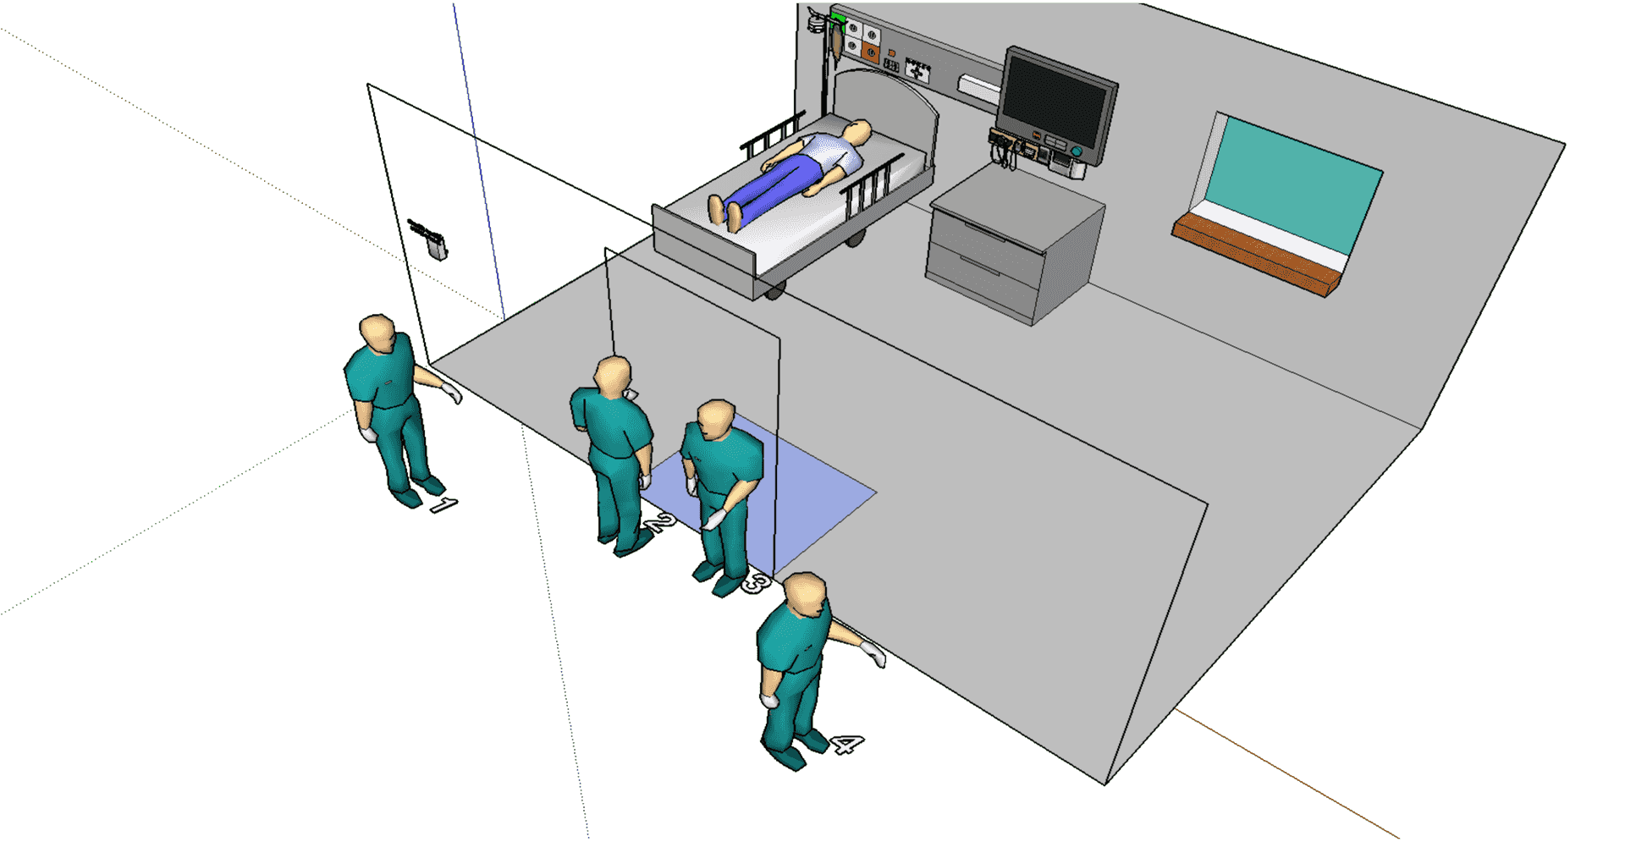
MPact BLE
The system will show all four positions as “Outside the room”

Slide 14
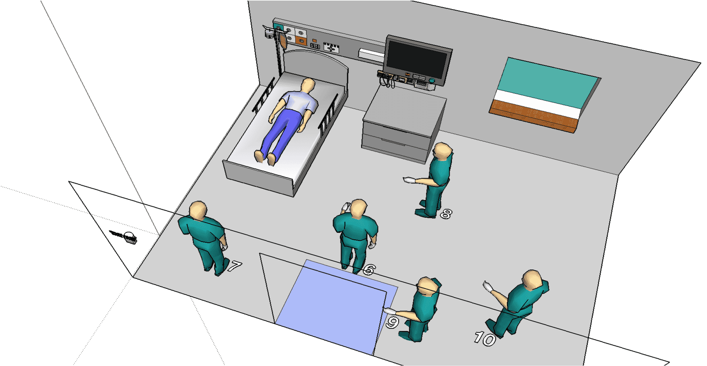
MPact BLE
System will indicate all positions shown here (6-10) as “inside the room.” All changes in location correctly identified within 2.5 seconds.

Slide 15
UWB Sub-Room Level Accuracy
Use MotionWorks tools to create virtual zones representing each hospital room or other discreet area on the facility map
Through configuration of the system only, an alert is generated on the screen for each room/area entered
Zebra’s UWB accuracy provides the customer with complete confidence in knowing the location and movement of people and assets, thereby enabling a maximum range of use cases.

Slide 16
UWB Infection Tracking
Proximity based alerts
Use Motionworks tools to create virtual zones around tagged people
Through a simple app development, we can provide alert on the screen for each proximity based interaction
UWB locate accuracy can be used to prove how confident one can be in the capture of interactions that can be traced backwards to find exposure risks
Zebra Confidential

Slide 17
Capability Summary – Increased accuracy enables increased use cases
BLE
  Room Level Accuracy and
  Location enables
    Wayfinding
    Patient and staff safety
    Basic workflow
    Asset management
UWB
  Sub-room level
  accuracy enables
    Enhanced asset management
    Clinical workflow optimization
    Infection tracking
    Auto-documentation
MotionWorks
Optimize operations
  Advanced data analytics
  Predictive analytics via pattern recognition
  Clinical protocol support and quantification
  Maximize use cases

Slide 18
Capability Summary –Zebra MotionWorks
Optimize performance improvement with MotionWorks
Technology integration to fit use cases
  Maximize functionality
  Minimize costs
  Optimize performance

Slide 19
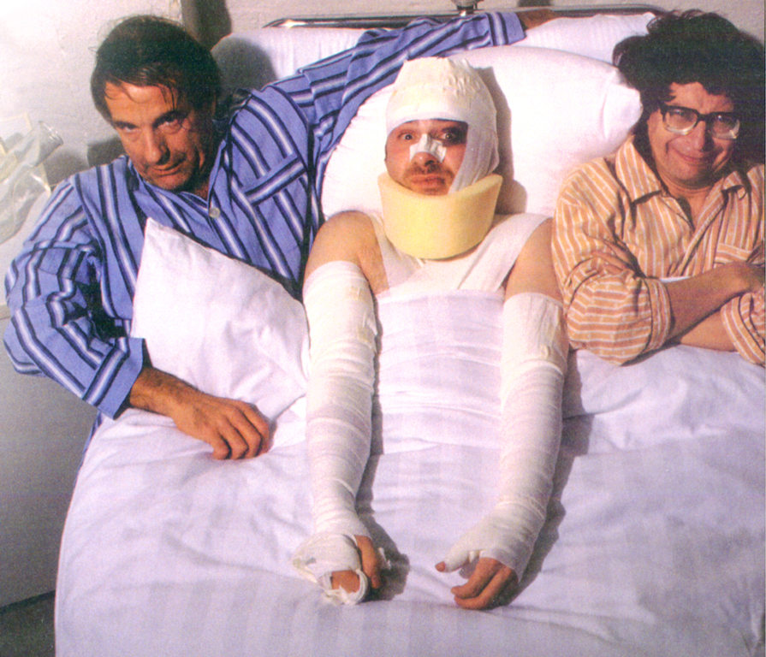
Scalability is a problem, because EDs are already overcrowded

Slide 20
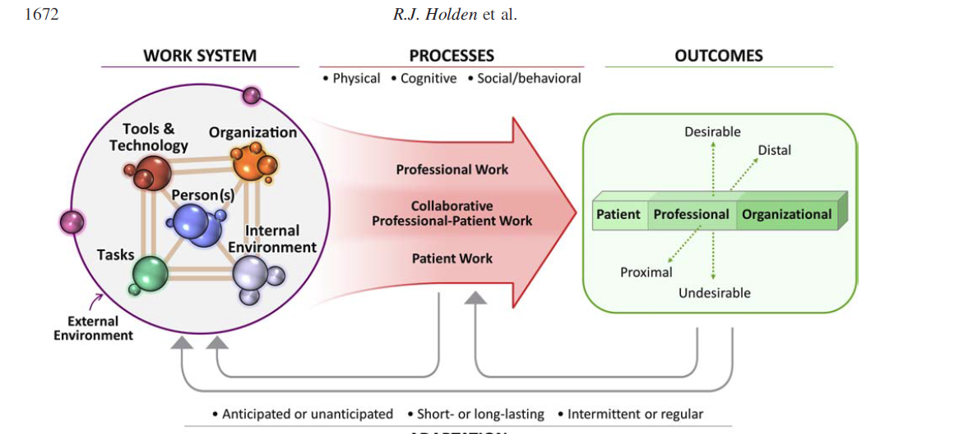
Complex System Analysis
Holden SEIPS 2.0 et al.Ergonomics, 2013

Slide 21
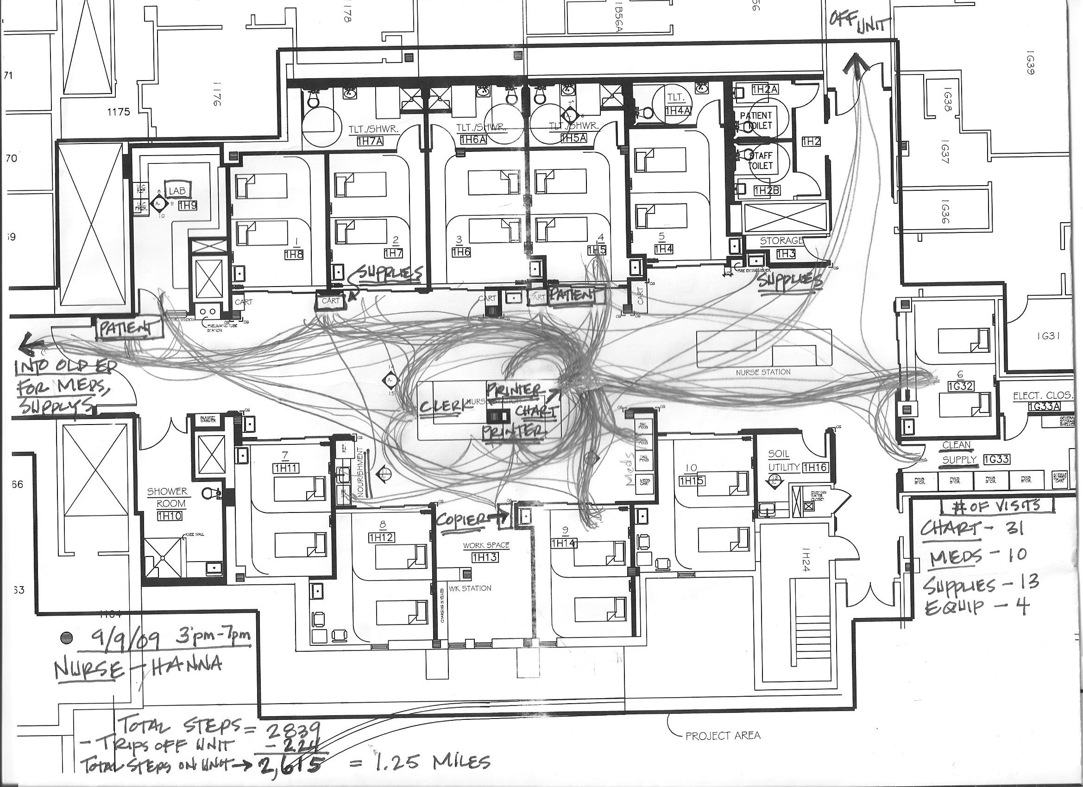
Lessons Learned Operations

Slide 22
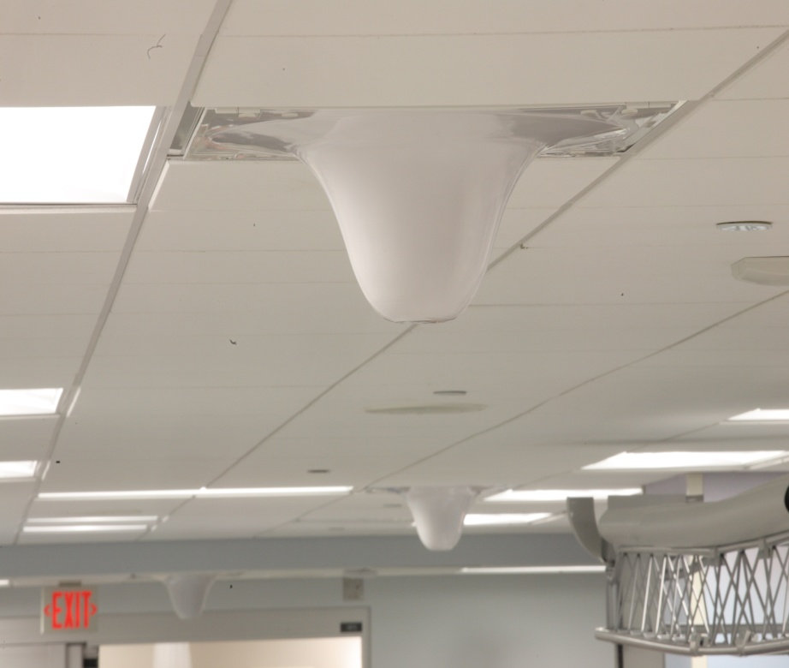
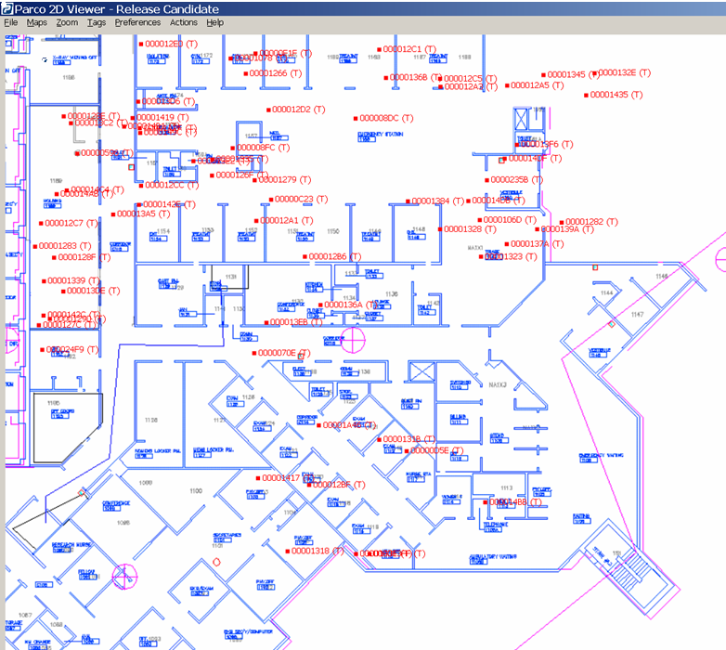
Staff and Asset Visibility

Slide 23
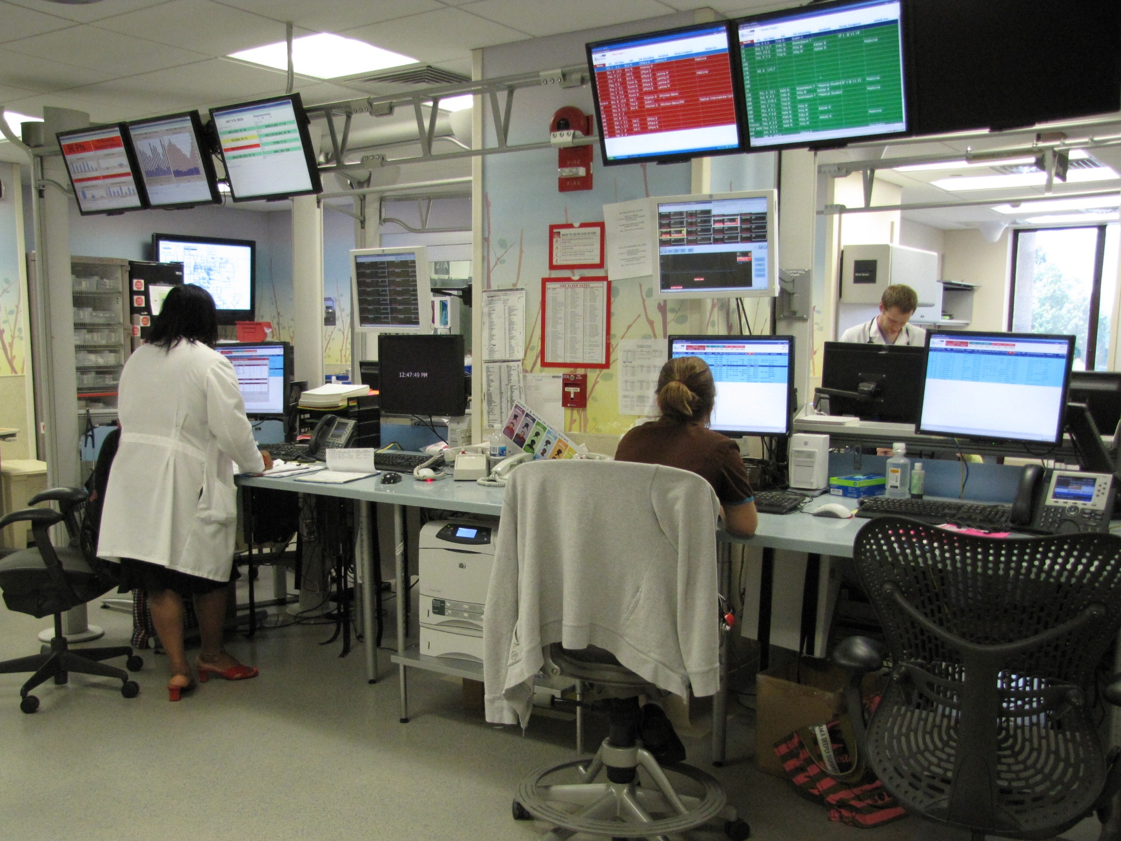
Notes:
Users modify design to meet their work requirements. Notice the horizontal truss has been inverted to support the attachment of situational awareness monitors/ dashboards. Requirement for proximate personal storage still not met.

Slide 24
Less than Half of Essential Workers Are Willing to Report to Work During a Serious Pandemic
“Motivation to work during a serious pandemic was associated with workplace safety measures and trust in the employer’s ability to protect workers from harm.”
Journal of Occupational and Environmental Medicine, October 2010

Slide 25
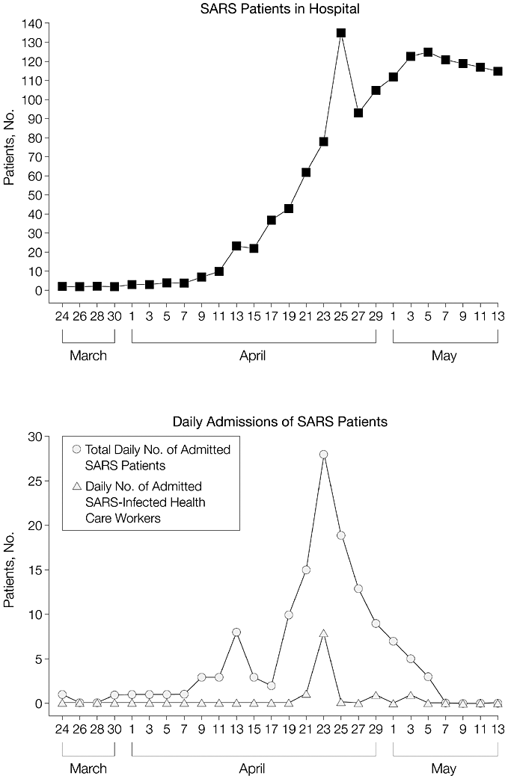
Cases of Severe Acute Respiratory Syndrome (SARS) Among Patients and Health Care Workers at First Hospital of Peking University, Beijing, China, March 24 through May 13, 2003
Li, L. et al. JAMA 2003;290:2662-2663.
Copyright restrictions may apply.

Slide 26
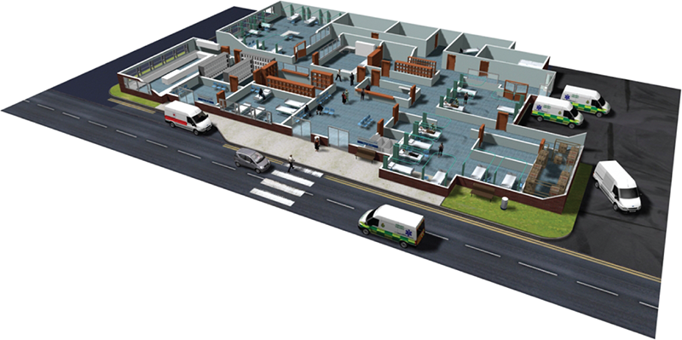
Zebra Location Solutions
Use Case Summary—Typical Hospital
Hospital Units:
Tag & Track Patients & Assets
Barcoded ID Bracelets, Meds & Supplies
Workflow Optimization
Automated Capture of all Patient Events
Bed Capacity Mgmt
Hand Hygiene
Patient Safety/Fall Detection
Infant Security
Elopement Prevention
Pharmacy:
Barcoded Meds
Par Value Mgmt
Controlled Substance Tracking
Temp/Humidity Monitoring
ER:
Tag & Track patient
Barcoded ID Bracelet
Automated Capture of all Patient Events
Workflow Optimization
Asset Tracking
Bed Capacity Management
Hand Hygiene
Patient Safety
Lab:
Barcoded Specimens
Asset Tracking
Temp/Humidity
Blood Bank:
Barcoded Supply Mgmt
Temp/Humidity
Age Monitoring
Admissions-
Barcoded ID Bracelet
Patient’s RTLS Tag
Bed Capacity Management
26

