Slide 1
Federal, State, and Local SDoH Health IT Initiatives
Anita Samarth
CEO, Clinovations GovHealth
February 2016

Slide 2
This Year’s Buzzword BINGO!
B | I | N | G | O
Social Determinants | Uber for Health | Lyft for Health | Social Determinants | Food Insecurity
Food Insecurity | Social Determinants | SDH | Social Determinants | Transportation
Social Determinants | Housing | Social Determinants | Social Determinants | Housing
SDOH | Food Insecurity | Food Pharmacy | Lyft for Health | Social Determinants
Food Prescription | Social Determinants | Uber for Health | SDH | Food Insecurity
Social Determinants | Lyft for Health | Social Determinants | Social Determinants | Transportation
Transportation | #SDOH | Social Food Insecurity | Food Pharmacy | Social Determinants
Social Determinants | Food Pharmacy | Social Determinants | Uber for Health | SDOH
Lyft for Health | Uber for Health | #SDH | Social Determinants | Farmacy

Slide 3
Who We Are: Experts in Health IT & Quality
Woman and Minority-Owned Small Business
Connecting public and private sectors
Doctors
Strategists
Putting strategies into practice
Technologists
Payment Reform
Nurses
Clinicians
ACOs
PCMH
Researchers
CQMs
MU
Policy Experts
Experienced consultants and clinicians with on-the-ground experience
Public Health
Program Management
Delivering health technology solutions to Federal, State and Local clients
IT
Analytics
Notes:
ONC, DoD, AHRQ, ASPE, CMS, Health Systems

Slide 4
Our Recent SDH/SDoH/SDOH Activities
ONC: Landscape Analysis for SDOH
Multiple States/Regions:
HIE Sustainability and Planning
Medicaid HIT/HIE Focus
CMS: Quality Measures and eCQI
ASPE: HIE and non-EHR Trading Partners
Vendor Collaborations: SDOH Opportunities
Provider Orgs: EHR/HIE Implementation
Community Orgs: Engage in health IT

Slide 5
Goals for Today
Early snapshots of what I can share
Some really interesting examples
Not reinventing the wheel – presenting a lot of what’s available
Sources have been attributed!
The market is still evolving
But everyone understands it’s important!
It’s a long journey
An incredible volume of information available

Slide 6
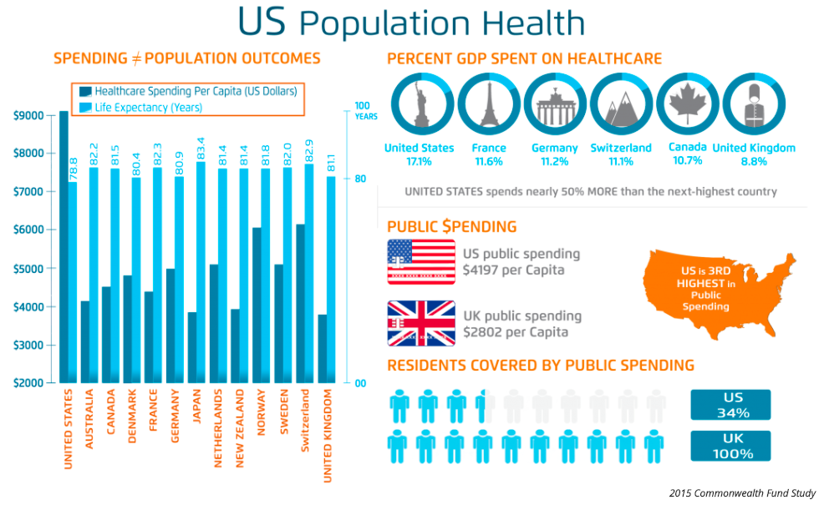
Some Good Stats
Source: Health Catalyst

Slide 7
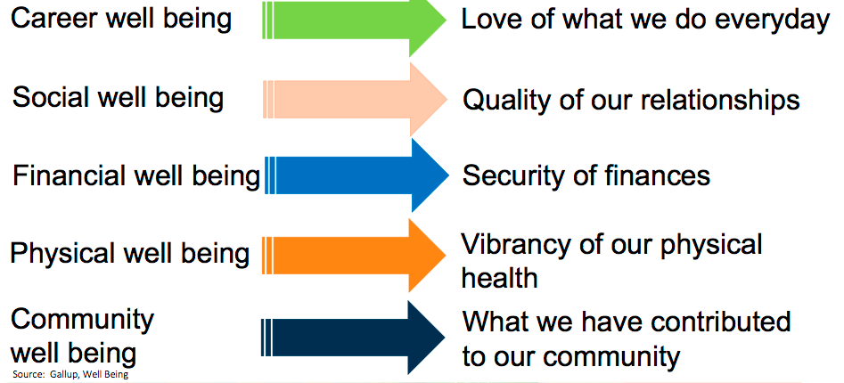
Essentials of Well Being
Source: The Root Cause Coalition - Diagnosis Hunger Presentations

Slide 8
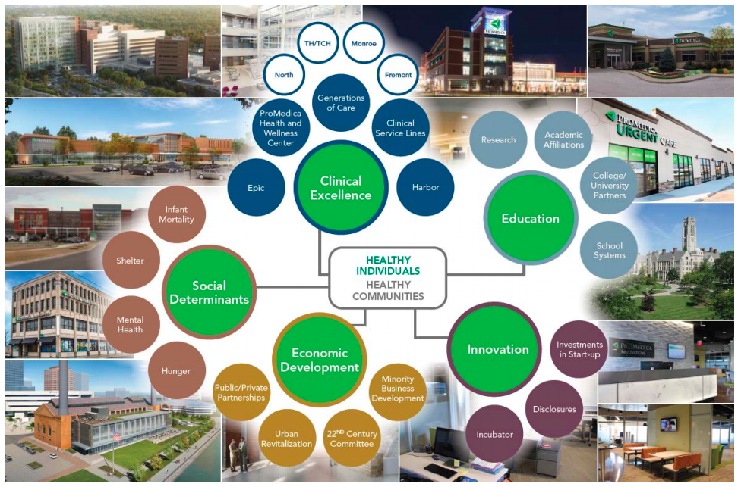
Health People: Healthy Communities
Source: The Root Cause Coalition and Promedica - Diagnosis Hunger Presentations

Slide 9
Health: Make vs. Spend
Source: Bipartisan Policy Center - What Makes Us Healthy vs. What We Spend on Being Healthy
Source: Bipartisan Policy Center - What Makes Us Healthy vs. What We Spend on Being Healthy

Slide 10
Lots of Great Background on “Why”!
Impact on Risk of Premature Death
KFF Social Determinants Factors
Source: Schroeder, SA. (2007). We Can Do Better – Improving the Health of the American People.
Source: Kaiser Family Foundation - Beyond Health Care: The Role of Social Determinants in Promoting Health and Health Equity

Slide 11
SDoH and Population Health

Slide 12
Lots of Activity
IOM Phase 2: Capturing Behavioral Domains and Measures in EHRs
Community Health Peer Learning Program
Comprehensive Primary Care+ (CPC+)
Accountable Health Communities (AHC)
CMMI
PRAPARE Tool: Protocol for Responding to and Assessing Patient Assets, Risks, and Experiences
Community Referral Solutions

Slide 13
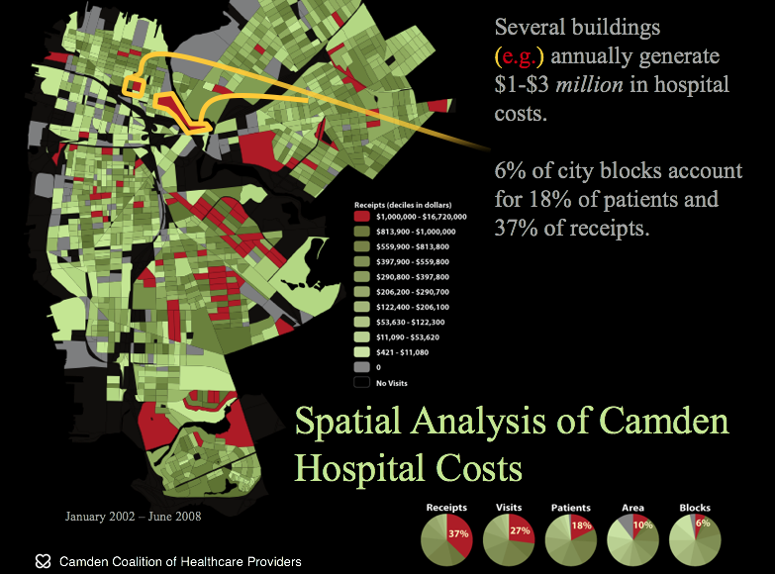
One We Hear About a Lot: Camden Coalition

Slide 14
Health IT and SDoH
Health IT / EHR for Screening
EHR Referrals to Community Services
Analytics and Risk Scoring Algorithms
Care Coordination/ Care Manager/ Community Resource Coordination
Most Mature SDoH Factors in Health IT:
Food
Transportation
Housing

Slide 15
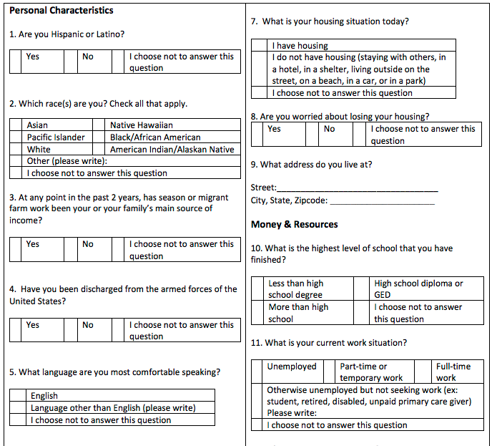
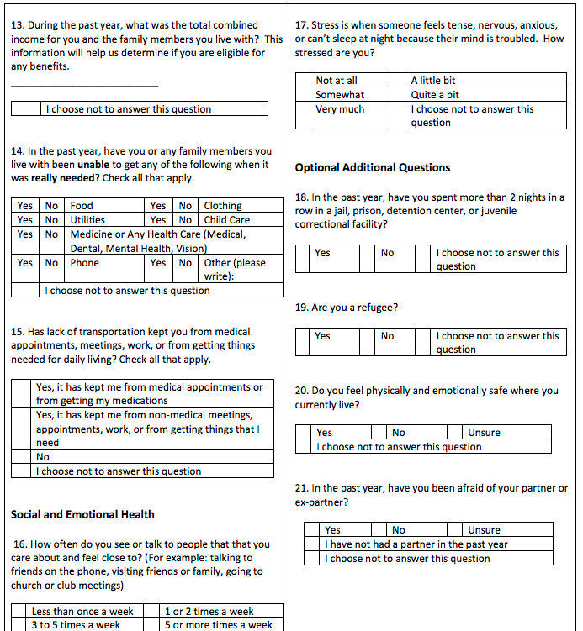
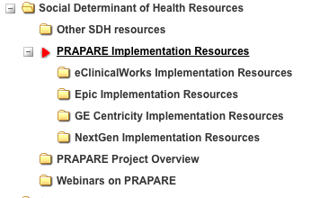
NACHC PRAPARE & EHRs

Slide 16
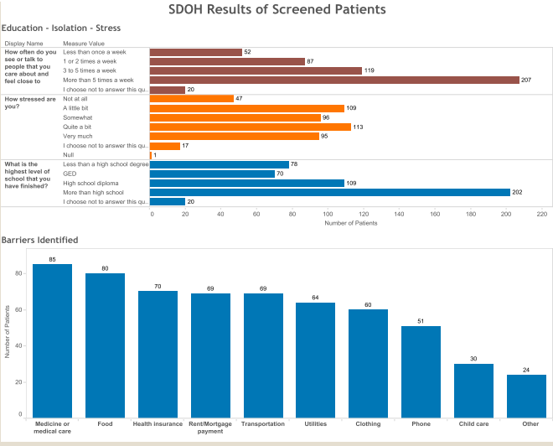
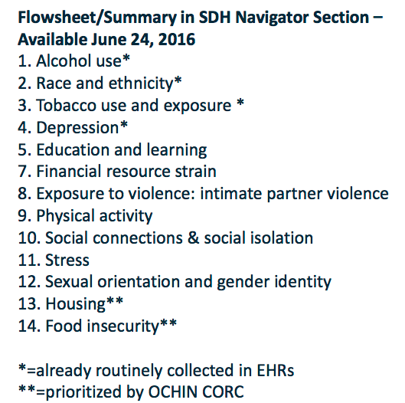
PRAPARE in EHRs
Source: La Clinica and OCHIN data in Epic PRAPARE Webinar

Slide 17
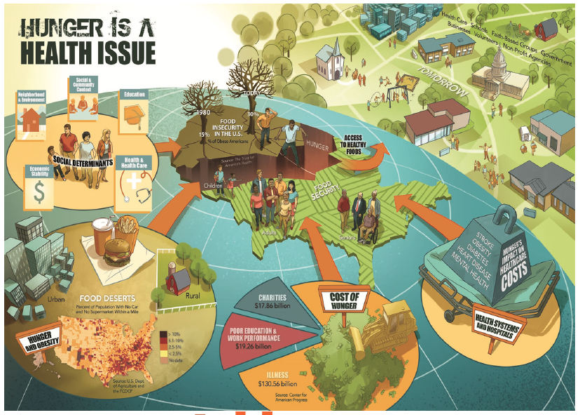
SDoH Spotlight: Hunger
Source: Promedica’s Journey: Addressing Hunger as a Health Issue

Slide 18
Food Insecurity Impact Example

Slide 19
Standards of Medical Care in Diabetes—2016
Recommendations
Providers should carefully evaluate hyperglycemia and hypoglycemia in the context of food insecurity (FI) and propose solutions accordingly.
Providers should recognize that homelessness, poor literacy, and poor numeracy often occur with food insecurity, and appropriate resources should be made available for patients with diabetes.
FI is the unreliable availability of nutritious food and the inability to consistently obtain food without resorting to socially unacceptable practices.
Hyperglycemia and hypoglycemia are more common in those with diabetes and FI.

Slide 20
From Feeding America

Slide 21
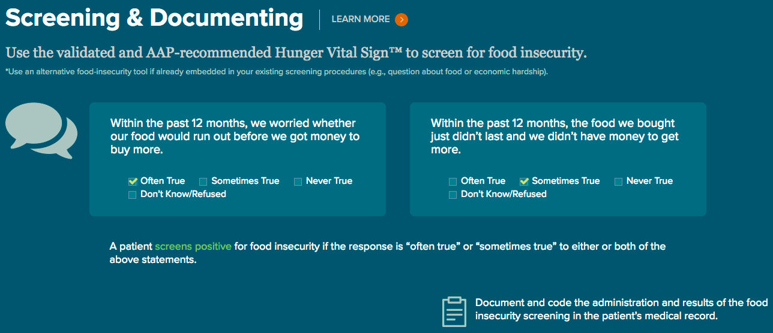
Food Insecurity: Hunger Vital Sign™
Food Banks
Food Pantry
Food Pharmacy
”Farmacy”
Food Prescriptions
Quality of Food

Slide 22
Examples in Other Domains
Transportation
Do you have transportation?
How long does it take you?
Housing
Situation changes
CDC findings: The groups with the highest frequency of always being worried or stressed about having enough money to pay their rent or mortgage were respondents with
incomes less than $25,000,
people without health insurance at the time of survey,
renters, and
people with a self-reported history of 3 or more adverse childhood experiences.

Slide 23
Questions and Discussion

Slide 24
THANK YOU!
Anita Samarth
anita@GovHealth.com

