Slide 1
PRAPARE
A Social Determinants of Health
Case Study
May 15, 2017

Slide 2
Agenda
Introductions
Company Overview
Case Study – PRAPARE

Slide 3
About Altruista Health I Evolution
Altruista Health was founded in 2007 with a mission to provide highly advanced yet intuitive care management solutions to be used by caring health professionals serving vulnerable populations.
Altruista Surpasses
15 million members on platform
Dec. 2015: Investment
from Capricorn Healthcare
Altruista Health Founded
Hyderabad office opens
First National Client Signed
2007
2008
2009
2010
2011
2012
2013
2014
2015
2016
2017
GuidingCare is Generally Available
UM V1 Module
is Released
GuidingCare G7 is Released
Mobile Clinician App is Released

Slide 4
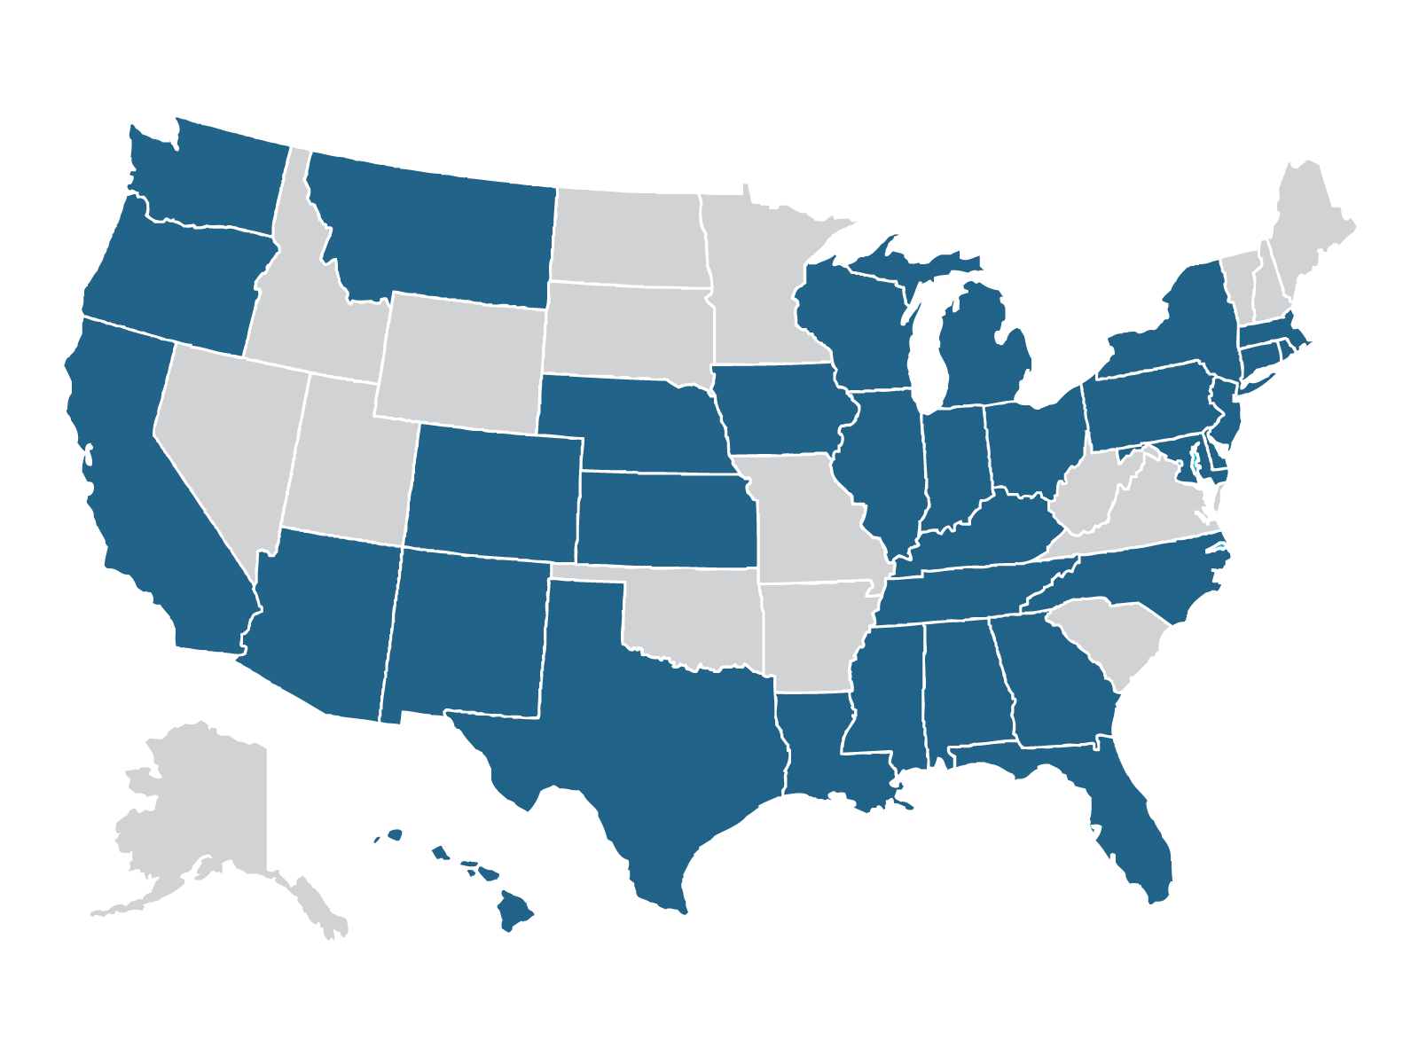







About Altruista Health I Today
335+
Delivering
Complex Care Solutions in
Staff Across
US & India
34 States
Representative Clients:
1 in 5
Medicaid beneficiaries have
care managed on GuidingCare™

Slide 5

National Scale I Key Metrics
15M+
Managed Gov’t Lives
Across All Client
Installations
1.8B+
Transactions
Per Year on Largest
Production Instance
35K+
Users
Accessing the
System Nationally
9
MLTSS/MMP/Foster Care
State Implementations
(NY,OH,TX,NM,HI,IA,VA⁽¹⁾)
10K
Admit/Discharge/Transfer Notifications Per Day
(On Single System)
Note: (1) In progress, July 2017

Slide 6
GuidingCare8 I Expanded Module Set: High Level
Product Roadmap
Enable Shift to Collaborative
Care Models, Drive Quality
Improvement, and Reduce
Medical Spend
CM
mC
UM
AG
PA
CRM
Collaborative
and Configurable
Care Management
Mobile Clinician
Platform for
Offline Care
Robust Utilization
Management
Capability
Appeals
and
Grievances
Integrated
Predictive
Analytics
Integrated
Customer
Service
Payer
PH
DIR
BD
mP
Drive Care and Quality Shift From Payers to Providers To Support New Clinical Models
Provider
Population
Health
Management
DIRECT
Messaging for EHR
Integration
Big Data
Population Health
Analytics
Mobile Provider
For Care Coord.
and Transitions
Deliver Patient Engagement
To Improve Experience,
Inform Patient, and Drive
Contract Performance
MP
mM
INC
LEGEND
Generally
Available
Member
Member Portal
For Integrated
Health Record
Mobile Member
To Engage Care
And Monitor
Member
Incentive
Solutions
In
Beta
Regulatory &
Innovation
Rx
EVV
SDH
HIT
Innovate With Solutions
For State & Regulatory
Initiatives and HIT Investments
On
Roadmap
Social
Coordination for
SDoH Initiatives
Health IT
Integration with
HIE (ADT,C-CDA)
Pharmacy
Module with
MTM
Electronic
Visit
Verification
3

Slide 7
PRAPARE
A Case Study

Slide 8
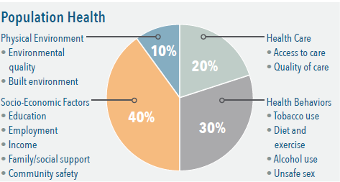

PRAPARE
PRAPARE = Protocol for Responding to and Assessing Patient Assets, Risks and Experiences
Unique partnership between AlohaCare and Waianae Coast Comprehensive Health Center (WCCHC) on the island of Oahu in Hawaii
Leveraging Social Determinants of Health (SDoH) as part of a holistic approach to Population Health enabling clinical and nonclinical care in partnership with community-based organizations
AlohaCare/Waianae population is a safety net population with multiple SDoH determinants in play
  Poverty and/or income insecurity
  Physical activity
  High school education
  Smoking

Slide 9
Objectives and Key Success Factors
Key Objective
  Identify the most complex patients using the PRAPARE risk assessment model
  Develop cost-savings method
  Maintain and/or improve the overall quality of care
Success due to a well-planned balance of people, processes, and IT (GuidingCare™)
PEOPLE
(Extended Care Team)
+
PROCESS
(Member Assessment, Primary care, Care Managers)
+
IT
(Guiding Care)
=
PARTNERSHIP
(AlohaCare, WCCHC)
“Research demonstrates that improving population health and achieving health equity will require broader approaches that address social, economic, and environmental factors that influence health” {Kaiser Family Foundation}

Slide 10
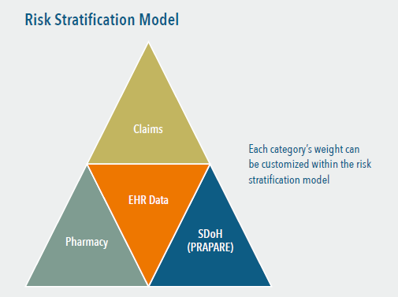
Altruista GuidingSigns
Uses risk stratification tool to incorporate customized algorithms based on SDoH and component weighting
Incorporated risk modeler is the Chronic Illness and Disability Payment System (CDPS)
Captures PRAPARE data into workflow in an EHR that includes prompts for the care team alerting them to incomplete assessment screening, and/or high risk screening criteria

Slide 11
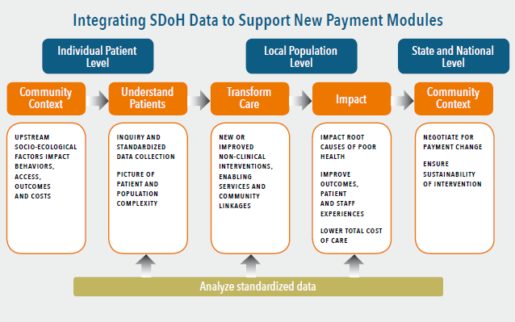
SDoH Supports New Payment Models
SDoH important for the treatment of holistic health, the enablement of a true primary care medical home care delivery model, and emerging value based reimbursement (VBR) models in both government sponsored and private sector lines of business.
PRAPARE provides a better picture of risk than just claims and clinical data alone

Slide 12
Conclusion – Effective Population Health Management
Requires a thorough assessment of the holistic picture of an individual’s health, including population-specific SDoH factors used by the PRAPARE tool that provided a meaningful foundation for developing a comprehensive population health program
  Each population group may require slightly different assessment tool questions to identify and analyze specific determinant factors.
For this safety net population example, the PRAPARE tool provided a meaningful foundation for developing a more comprehensive population health program, including the roadmap for an effective risk stratification tool enabled by GuidingCare.
Population health managers need to manage the complex interplay between care interventions, risk assessments, and tools
GuidingCare seamless care plan and risk stratification capabilities enable providers and payers to create a more comprehensive picture of patient health and identify potential risks for future chronic conditions

