Slide 1
Cyber Security in HealthIT
Mark Longworth
Independent Security Consultant
mlongwth@gmail.com

Slide 2
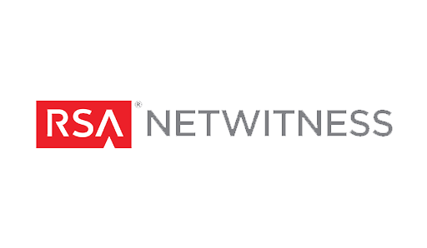
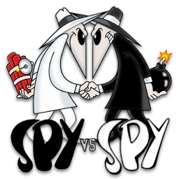
Who Am I?
CIA Telecommunications Engineer
Invented NetWitness: Network Forensics Analysis Tool
(Spyware)
Worked with the Intelligence Community to develop Forensics (spyware) and Counter-forensics (counterintelligence) solutions
Challenged to investigate Health IT Security

Slide 3
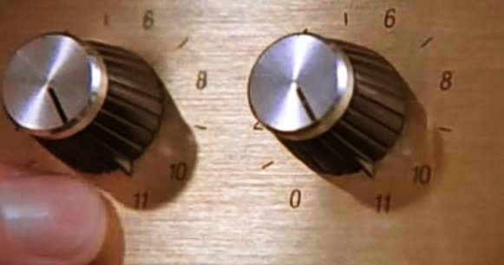
SECURITY
SECURITY

Slide 4
Where are we now?
Human Error
Spy v. Spy → Criminal: Health IT
Anthem (78m), Premera (11m), UCLA (4.5m), CareFirst (1.1m)
In 2015: 43 reported hacker incidents, 110m breached records[1]
Hacking, Theft/Loss (Laptop)
PHI is worth money… you all have it
[1] https://ocrportal.hhs.gov/ocr/breach/breach_report.jsf

Slide 5
But Wait… It’s Worse
FDA / HHS warning on Medical Devices
FDA Warning (Hospira’s LifeCare PCA3 and PCA5 Infusion Pump Systems)
FDA / HHS warning on Medical Mobile Application
Security errors can cost you:
Money: Hard Losses, Reputation Losses, Remediation Losses, Penalties
Life: Medical Devices hacked could lead to death or serious injury

Slide 6
Oh Yeah, and Also…
EMR systems still being adopted
ICD-10 Conversions
Interoperability
Communications systems lag other industries (Ponemon)
Patient Capture systems: ZocDoc, etc.
BYOD
Cloud
…

Slide 7
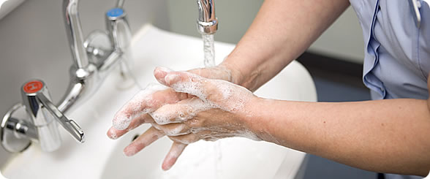
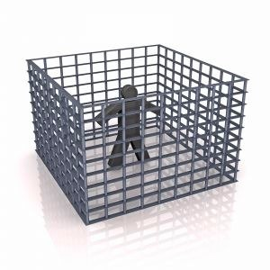
What People are Saying To Do
Perform a Risk Assessment
Follow good cybersecurity hygiene
Don’t use default passwords
Isolate things in your network

Slide 8
What can you do?
SECURITY
SECURITY

Slide 9
What Can you REALLY Do?
Risk Management Framework from NIST / NIST 800-66
Get Organized
Get Structured
Prioritize
Advance Maturity
HIMS Risk Assessment Toolkit
Other tool kits

Slide 10
Questions?
Mark Longworth
Independent Security Consultant
mlongwth@gmail.com

