Slide 1
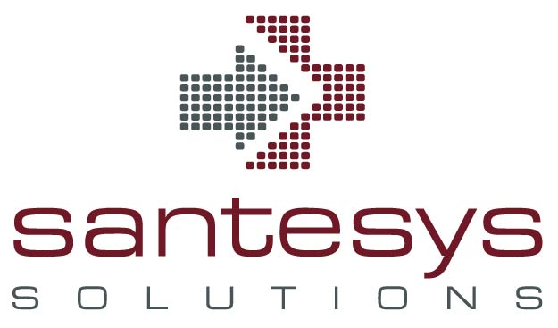
2018: Uncertainty & Change Meet Innovation
HealthTechNet Discussion – January 19, 2018
Deanne Kasim
Santesys Solutions

Slide 2
It’s Not Just the Tech, It’s Uncertainty
Leaves many questions about the future of U.S. healthcare system
  Forthcoming dismantlement of ACA provisions?
  Future of expanded Medicaid?
  Effect of more probable increase in the uninsured rate?
Will (real) progress happen on drug prices?
  This whole sector needs to be disrupted – not just by Amazon
  Role of the “middlemen” (PBMs, wholesalers) under scrutiny
  Value-based contracting for drugs growing trend for insurers and employers

Slide 3
That Pesky Cybersecurity, Confidentiality Thing
Expect more sophisticated attacks for ransom
  “…20% or more of a CIO's time will be spent on cybersecurity. If you look at the trends over the past 20 years, in 1996, my worst threat was MIT freshmen. Today, it's state-sponsored cyberterrorism, hactivism and organized crime” – John Halamka, CIO, Beth Israel Deaconess
E.U. and the General Data Protection Regulation (GDPR)
    E.U.’s GDPR goes into effect May 25, 2018 – will U.S. look at this model?
    Under GDPR, before processing ANY personal data, business must ask explicit permission from individual. In PLAIN language (not legalese)
    Violation = greater of 4% of annual global revenue or 20M Euros
    Pertains to all companies handling data even if not based in E.U.

Slide 4
Artificial Intelligence (AI) – Let’s Get Real
Separating frenzy from reality
  Some investors pressuring small companies to put AI in the mix (keeping up with the Joneses vs. real value)
What is driving real adoption now? Findings from the JASON Report (Dec 2017)
  Updating, replacing legacy infrastructure that cannot support AI
  Ubiquity of networked, smart devices within society
  Acclimation to convenience and at-home services (i.e., Amazon)
Creating real use cases that fit AI-powered solutions into workflow
  For analytics this is an imperative

Slide 5
Getting Comfortable with Precision Medicine
“Approximately 160 hospitals, health systems will be highly likely to purchase precision medicine solutions in 2018” - HIMSS Analytics
  Oncology – top focus area
A precision medicine solution must address:
  Clinical trial matching
  Clinical decision support
  Molecular tumor board support
  Data sharing across networks
  Data warehousing and analytics
    (Source: 2017 survey by The Health Management Academy)

Slide 6
Blockchain – The “It” IT of the moment
“Blockchain is now similar to AI in 2016…will soon be the functionality every security vendor (wants)” – Forrester Research
Developing actionable use cases for healthcare
  Malware and ransomware protection via binary reputation checks
  Claims, payment and clinical data clearinghouse platforms (Cognizant, Change Healthcare building this out)
  IoT (supply chain, clinical wearables)
Watch these groups for more developments
  Hyperledger (open source collaborative effort sponsored by Linux Foundation)
  Hashed Health (consortium of healthcare companies)

Slide 7

Questions, Follow Up
Deanne Kasim, Santesys Solutions
  dkasim@santesys.net
Don’t Miss the Future of Healthcare – HLTH event May 6-9, 2018 at the Aria, Las Vegas! (SANTESYS150) gets you registration discount!
The HLTH event covers innovation in healthcare that is driving substantial reduction in costs and dramatic increase in quality. Convening government, pharma, biotech, payers, providers and investors.

