Slide 1
What Is Disease-Space, and What Are Its Implications for Predictive Medicine and Healthcare Innovation?
James Sorace MD MS
jamessorace1@gmail.com
410-802-7340

Slide 2
Disclaimer
The findings and conclusions of this report are those of the author and do not necessarily represent the views of the Assistant Secretary for Planning and Evaluation, the Centers for Medicare & Medicaid Services, or the Department of Health and Human Services.
Dr. Sorace recently retired from hhs.

Slide 3
What is Disease-Space and Why Should You Care?
Disease-Space (DS) is the frequency distribution of individual combinations of co-morbidities at the population level (i.e. how many unique problem list are there and how many patients share each list?).
If DS is limited to a small number of combinations of comorbidities and can be predicted (e.g. from heredity) then the following goals of predictive analytics are easy (if not they are difficult):
  Generalizing the results of clinical trials
  Development of clinical decision support algorithms
  Measurement of quality of care

Slide 4
Presentation Overview
Comorbidity: Project 1, “The Combinatorial Complexity of Diseases in Medicare.”
Heredity: Project 2, “The ASPE/CMS Twin Study.”
These projects focus on the theme of DS from different perspectives.
  Studies of diseases combinations (DCs) quantify the shape and other properties of the DS distribution.
  Twin studies provide measures of DS similarity between specific pairs of individuals with MZ twins having maximum similarity and informs models of prediction (i.e. how similar can 2 people be?).
    Developed a novel twin study design based on demographically matched control pairs (MCP).

Slide 5
ASPE/CMS Data Infrastructure
These projects were done as part of the “Medicare DataLink” project with Acumen LLC.
Database contains all Medicare Fee For Service Part A and B claims since 1991.
  These projects used CMS’s Hierarchical Conditions Categories (HCCs) system to group diseases. System developed for economic risk adjustment.
    Condition categories (CCs) map all of the approximately 15,000 5-digit codesICD-9 codes to 184 CCs.
    HCCs consolidate approximately 3,000 5-digit ICD-9-CM codes most associated with a prospective 12-month increase in expenditure into 70 disease groups.
    For more information on HCCs see: Risk adjustment of Medicare capitation payments using the CMS-HCC model. Pope GC, Kautter J, Ellis RP, Ash AS, Ayanian JZ, Lezzoni LI, Ingber MJ, Levy JM, Robst J. Health Care Financing Review. 2004 Summer; 25(4):119-41.
Notes:
HCC = CHF, metastatic cancer etc.

Slide 6
Project 1: What is the Shape of The DS Distribution?
Data included all 2008 Beneficiaries with continuous fee for service claims history.
  32,220,634 Beneficiaries
  $283,088,306,347
At the 184 CC level over 23 million DCs were detected. 99.6% of them were unique (contained only 1 beneficiary). To complex to interpret.
At the 70 HCC level 2,027,394 Disease Combinations (DCs) were detected.
DS is a long-tailed distribution consisting of numerous small cells of patients with similar DCs.

Slide 7
Disease Combination Analysis
Four Groups Were Identified:
Group | % of Beneficiaries | % of Expenditures
1) No HCC | 35 | 6
2) 100 most prevalent DCs | 33 | 15
3) Remaining 2,072294 DCs | 32 | 79
4) 1,658,233 Unique DCs | 5.1 | 35
Notes:
We are all snowflakes.

Slide 8
Example DCs by Prevalence (1-5 and 96-100)
DC Rank | Number of Beneficiaries (%) | HCC(s) describing the DC
1 | 1,667,891 (5.17647) | 19_Diabetes without Complication
2 | 764,522 (2.37277) | 10_Breast, Prostate, Colorectal and Other Cancer
3 | 723,760 (2.24626) | 108_Chronic Obstructive Pulmonary Disease
4 | 610,943 (1.89612) | 105_Peripheral Vascular Disease
5 | 531,536 (1.64968) | 92_Specified Heart Arrhythmias
96 | 19,237 (0.05970) | 27_Chronic Hepatitis
97 | 19,196 (0.05958) | 54_Schizophrenia & 108_Chronic Obstructive Pulmonary Disease
98 | 18,806 (0.05837) | 80_Congestive Heart Failure & 92_Specified Heart Arrhythmias & 131_Renal Failure
99 | 18,754 (0.05820) | 101_Cerebral Palsy, Other Paralytic Syndromes
100 | 18,643 (0.05786) | 38_Rheum Arthritis and Inflammatory Connective Tissue Disease & 55_Major Depressive, Bipolar, Paranoid Disorders

Slide 9
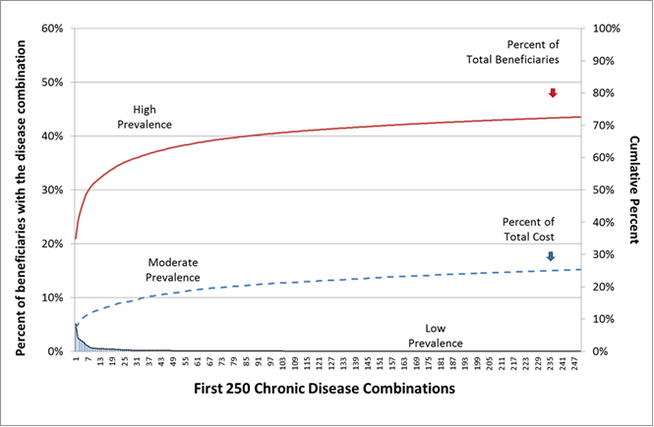
Long Tailed Distribution of Medicare’s DS
The graph displays the first 250 Diseases Combinations, ranked by prevalence, from the baseline HCC analysis. Note that the left Y-axis represents the proportion of the population that is included in each unique disease combination (black line). The right Y-axis represents the cumulative percent of the total population (red line) and the total expenditure (blue line), and is adjusted for the 32% of beneficiaries and 6% of expenditures that are associated with the no-HCC population. As there are over 2 million disease combinations calculated by this methodology, the figure’s X-axis would need to be extended over 8,000 fold to the reader’s right before both cumulative lines reached 100%.
Notes:
We are all snowflakes!
Many disease combinations would meet the criteria for a “rare disease” with the 10th DC being below 200,000 (actually about 184,000). This represents about 48% the population.
Meeting the needs of “rare patients” is the “North Star” for improved health.
Even the largest providers will frequently encounter patients for which they do not have extensive data. Similar patients are distributed across the nation and across time.
These findings point out the need for a large and highly collaborative network that supports decentralized problem solving.

Slide 10
Can We Prioritize Prevalent Conditions?
Restricting analysis to the 20 most prevalent HCCs yields 53,476 DCs covering 40% of the population and 27% of expenditures.
Prioritizing quality interventions based on prevalent diseases may yield benefits but they may be less than the anticipated.

Slide 11
Project 1 Conclusions
Medicare’s DS is a “long tailed” distribution even with a coarse coding schema.
  Concept of a normal distribution does not apply.
  No useful mean or variance.
There is no “average” or “typical” complex patient.
  Rare patients are common. Very similar to patients with rare diseases.
  Current quality measures based on prevalence may yield benefits but they will be limited.
  May need to share information about a specific patient nationally across several patients/providers to inform care.

Slide 12
Project 2: ASPE/CMS Twin Study
In collaboration with VCU’s Mid-Atlantic Twin Registry, we matched 396 pairs of MZ or “Identical” twins and 378 pairs of DZ or “Fraternal” twins to their Medicare claims data from 1991 through 2011.
Studied pairs were predominantly white, male and Mid-Atlantic, and only included individuals in which both members survived to age 65.

Slide 13
MCP Methodology VS Traditional Twin Study
Group | “Familial Genetics” | Shared Family Environment | Controls For Demographics
MZ | 100% | Yes | No
DZ | 50% | Yes | No
MZ-MCP | 0% | No | Yes
DZ-MCP | 0% | No | Yes

Slide 14
Twin Study Results: Shared HCCs
MZ (identical) twins shared 6.5% more HCCs than their MZ-MCP (26.3% vs. 19.8%, P<0.001).
DZ (fraternal) twins shared 3.8% more HCCs than their DZ-MCP (25.6% vs. 21.8%, P<0.001).
MZ-MCP/DZ-MCP (19.8% vs. 21.8%, p= 0.029)
MZ/DZ (26.3% vs. 25.6%, p=0.52)
Notes:
Shared across all HCCs.
File Type MZ Sample MZ -MCPSample # Total HCCs # Shared HCCs Proportion of Shared HCCs Lower 97.5% Upper 97.5% # Total HCCs # Shared HCCs Proportion of Shared HCCs Lower 97.5% Upper 97.5% IP 1,927 406 0.211 0.162 0.254 2,006 294 0.147 0.109 0.184 OP 1,512 298 0.197 0.154 0.237 1,463 162 0.111 0.072 0.150 PB 3,237 804 0.248 0.212 0.284 3,269 614 0.188 0.157 0.219 ALL 3,785 994 0.263 0.229 0.295 3,798 752 0.198 0.168 0.230 File Type DZ Sample DZ-MCP Sample # Total HCCs # Shared HCCs Proportion of Shared HCCs Lower 97.5% Upper 97.5% # Total HCCs # Shared HCCs Proportion of Shared HCCs Lower 97.5% Upper 97.5% IP 2,049 344 0.168 0.131 0.206 2,144 308 0.144 0.105 0.185 OP 1,585 252 0.159 0.121 0.197 1,572 174 0.111 0.077 0.145 PB 3,407 814 0.239 0.203 0.275 3,441 634 0.184 0.152 0.218 All 3,966 1,016 0.256 0.221 0.290 4,017 876 0.218 0.187 0.250 File Type Proportion comparison p-values MZ/MZ-MCP MZ/DZ DZ/DZ-MCP MZ-MCP/DZ-MCP IP 0.0000 0.001 0.031 0.791 OP 0.0000 0.006 0.000 0.997 PB 0.0000 0.369 0.000 0.707 All 0.0000 0.518 0.000 0.029

Slide 15
Twin Study Disease Correlation Summary
HCC (#) | Arrhythmias (92) | Stroke (96) | Diabetes & Renal (15) | Pollyneuropathy (71)
MZ vs. MZ-MCP | +* | +* | + | +
MZ vs. DZ | - | - | + | +
DZ vs. DZ-MCP | +* | - | - | -
* Not Significant if ICD-9-CM code 427.3 (Atrial Fibrillation and Flutter) is excluded from the analysis.

Slide 16
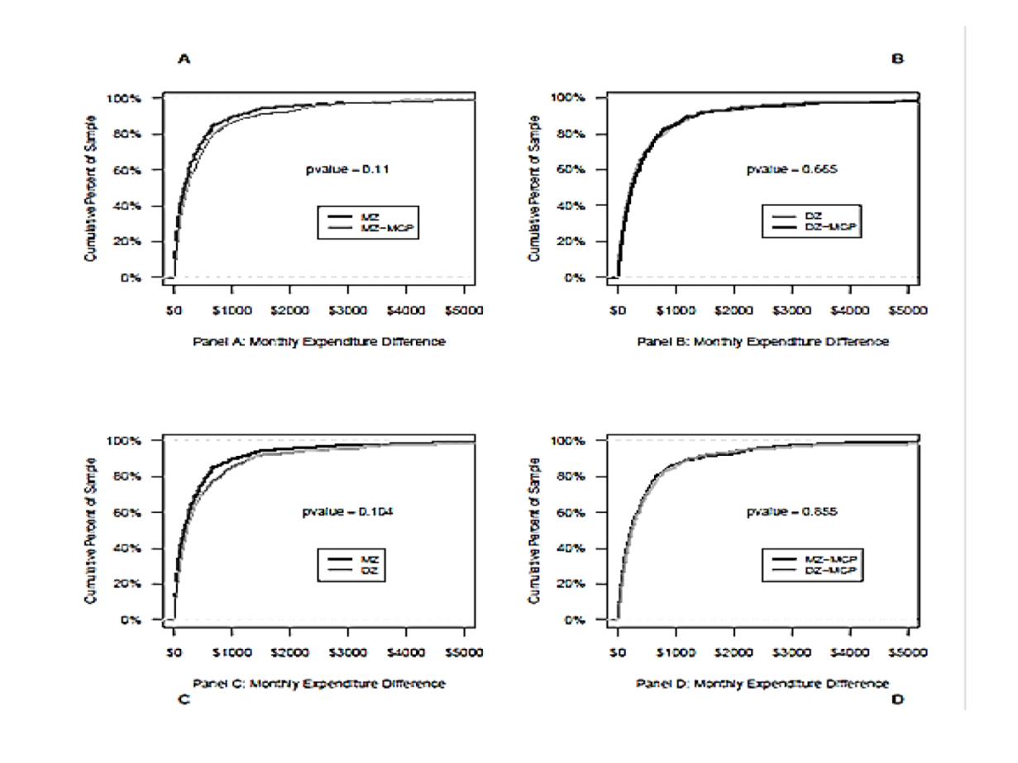
Heritability of Medicare Expenditures
Abbreviations:
MZ: Monozygotic twin group
DZ: Dizygotic twin group
MZ-MCP: Monozygotic matched control pair group
DZ-MCP: Dizygotic matched control pair group
KS-Test: P-values were calculated using the Kolmogorov–Smirnov (KS) test
A Comparison of Disease Burden Between Twins and Control Pairs in Medicare: Quantification of Heredity's Role in Human Health.
Sorace J, Rogers M, Millman M, Rogers D, Price K, Queen S, Worrall C, Kelman J. Population Health Management. 2015 Feb 6. [Epub ahead of print]
PMID: 25658666

Slide 17
Twin Study Conclusions
MCP methodology is viable and gave results that where distinct from and inclusive of those found with the tradition MZ vs. DZ design.
The role of heredity is limited in the study population.
However, due to multiple comorbidities, heredity may still account for 1 major disease for every 2 to 3 people (crude estimate).
Our findings are consistent with others:
  The predictive capacity of personal genome sequencing. Roberts NJ, Vogelstein JT, Parmigiani G, Kinzler KW, Vogelstein B, Velculescu VE. Sci Transl Med. 2012 May 9;4(133):133ra58. doi: 10.1126/scitranslmed.3003380. Epub 2012 Apr 2. PMID: 22472521
  Identically Different: https://www.youtube.com/watch?v=1W5SeBYERNI
    Note that new twin study designs include disease discordant pairs.

Slide 18
Where Are We Now?
The current generation of EHRs was built on:
  Structured data entry during provider encounters.
  Prevalence based quality measures.
  Traditional alerts and CDS that are often irrelevant for specific patients and do not necessarily improve provider situational awareness.
Both interoperability and data quality remain issues.
Limited ability to coordinate/communicate.
Similar problems in Europe.

Slide 19
Taming the Complexity of Disease-Space
The problem is to complex for centralized top down solutions.
Must expand current approaches to include a heavily AI supported crowd sourced knowledge management solution that facilitates care plan development for geographically and temporally dispersed specific patient clusters.
Systems that are optimized for rare diseases are a useful “North Star” as rare patients are the new normal.
New studies especially with deep learning and information theory are needed.
Many opportunities for pathology and diagnostic teams.

Slide 20
Move From HIT to HICT
Using HICT diagnostic teams will support two vital communication loops.
1st the “Inner Loop” provides care for specific patients within the organization.
  Still the subject of active research.
2nd the “Outer Loop” consist of selected communications at the national level to support the care of specific patient clusters.
  Search nationally for similar patients to identify clusters. These search functions may be built off of current efforts to support federated models of clinical research such as PCORI and OHDSI (note that the distinction between research and direct patient care will blur).
  Share knowledge about specific patient clusters between providers nationally using systems that may incorporate distributed clinical crowd sourcing functions such as those being used in Project ECHO.

Slide 21
Limitations
May not apply to the non-Medicare population
Use of HCCs as a disease aggregator.
For the Twin Study there was:
  Limited sex, race and geographic diversity.
  Limited number of twins.
  Both twins survived until 65.
For the Disease Combination Study:
  Only 1-Year Timeframe was used used.
  The order of diseases was not considered.

Slide 22
Thank You!
James Sorace MD, MS
jamessorace1@gmail.com
410-802-7340

Slide 23
Project 1: Publication
A Comparison of Disease Burden Between Twins and Control Pairs in Medicare: Quantification of Heredity's Role in Human Health.
Sorace J, Rogers M, Millman M, Rogers D, Price K, Queen S, Worrall C, Kelman J. Population Health Management. 2015 Feb 6. [Epub ahead of print]
PMID: 25658666

Slide 24
Project 2: Publications
  The complexity of disease combinations in the Medicare population. Sorace J, Wong HH, Worrall C, Kelman J, Saneinejad S, MaCurdy T. Population Health Management. 2011 Aug;14(4):161-6.
  Temporal variation in patterns of comorbidities in the Medicare population. Sorace J, Millman M, Bounds M, Collier M, Wong HH, Worrall C, Kelman J, MaCurdy T. Population Health Management. 2013 Apr;16(2):120-4. doi: 10.1089/pop.2012.0045. Epub 2012 Oct 31. PMID: 23113637

