Slide 1
Meaningful Use:
A Bumpy Ride on our Drive to Stage 2
David J. Vickers, MS-MIT, CRCE-I
Director of Project Management Office
Information Services Division
July 18, 2014

Slide 2
Agenda
About Virginia Hospital Center
Path to MU
MU Timeline
Evidence Book
Scope
  Application Mix
  Continuous Upgrades
  Clinical Quality Measures (CQMs) : 1 example of level of effort
Status: Where have we been? Where are we going?
Stage 2 Readiness
Lifeline?

Slide 3


About Virginia Hospital Center
342-bed community, not-for-profit teaching hospital in Arlington, VA
Mission: “To Be the Best Hospital”
Industry Recognized “Centers of Excellence”
  Magnet® certified by ANCC
  Truven Health Analytics:
    100 Top Hospital (2013 & 2014)
    50 Top Cardiovascular Hospital (2014)

Slide 4
VHC’s path to MU began before ARRA…
Launched Healthcare Information Services Transformation (HIS-T) Project in 2006
Strategic reasons :
  Automate manual processes
  Introduce new features, online medical record, physician order entry
  Achieve key business imperatives
    Reduce length of stay
    Increase employee, physician satisfaction
    Increase overall employee productivity
    Increase physician productivity
    Improve patient safety and quality outcomes
    Remain clinically ahead of competition
    Provide integrated easy data access across the organization
    Maintain profitability and positive cash flow
  Government & industry regulation and compliance
Source: VHC IS Selection Team Presentation to Board of Directors –
“Decision on a Hospital Information System (HIS)”, Sept. 27, 2006

Slide 5
Started well before ARRA of 2009
VHC’s Meaningful Use Timeline
July 2014
VHC is in CMS “Group 2” | FFY* 2012 10/01/2011 – 09/30/2012 | FFY 2013 10/01/2012 – 09/30/2013 | FFY 2014 10/01/2013 – 09/30/2014 | FFY 2015 10/01/2014 – 09/30/2015
Year # | 1 | 2 | 3 | 4
Stage & Milestone | MU Stage 1: “90-day” | MU Stage 1: “Full Year” | MU Stage 2: “Quarter” | MU Stage 2: “Full Year”
Criteria | At least 90-day period. Hospital can select dates | Entire federal fiscal year following year attained “90-day” | Must equal a Federal Fiscal Quarter starting 10/1, 1/1, 4/1 or 7/1 | Entire federal fiscal year following year attained “Quarter”
VHC Actual Period | 04/01/2012 – 06/30/2012 | 10/01/2012 – 09/30/2013 | 07/01/2014 – 09/30/2014 | 10/01/2014 – 09/30/2015
Attestation & Incentive Payment | Attested: 07/12/2012 Payment Amt: $2.2m Payment Rate: 100% Received: 08/24/2012 Attest to Pay: 42 days | Attested:10/17/2013 Payment Amt: $1.75m Payment Rate: 75% Received: 11/25/2013 Attest to Pay: 38 days | Target attestation: 10/2014 Target Payment Date: ~11/2014 Rate: 50% Amount: ~$1.1m | Target attestation: 10/2015 Target Payment: Date: ~12/2014 Rate: 25% Amount: ~$550k
Complete
Complete
* FFY = Federal Fiscal Year
Notes:
VHC’s pat

Slide 6
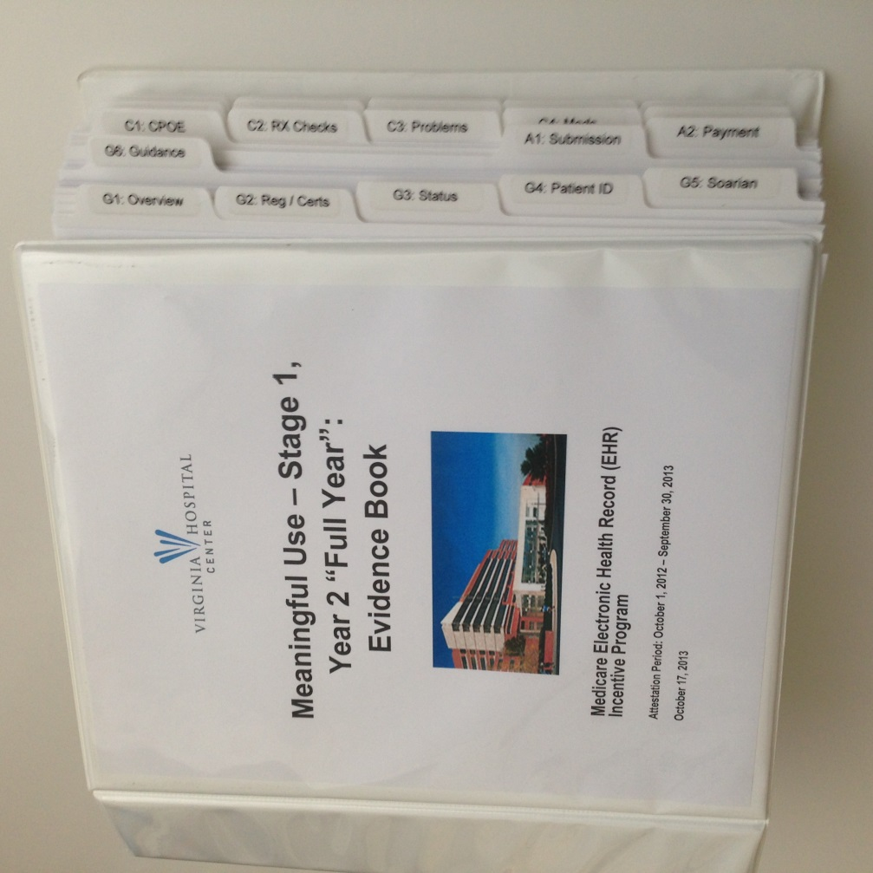
Evidence Book Assures Audit Readiness
Documents our journey
  Paper
  Electronic
Overall summary
Registration, Certification and Attestation info
CMS & Vendor guidance
Measure Info
  Description
  VHC Overview & Summary
  Summary & detail reports (from EHR-certified software)
  Validation results

Slide 7
Software Requirements for MU-2
VHC’s Upgrade Journey Since Fall 2013 = Still Not Complete:
Software upgrades and/or Hardware refreshes in all these areas…
Meaningful Use 2
Soarian Clinicals (SC) & Critical Care & Siemens Rx/MAK
LOINC Codes (Sunquest Lab & SC),
Exit Care
Soarian Financials, Electronic Document Mgmt.
HIE
(VHC & Va.) &
Patient Portal (Mobile MD / Siemens)
Healthcare Intelligence (DSS, SQM, HCQ)
Infrastructure OPENLink (interface engine), SCS, AIS
…Most - but not all - are done…
…Led to date shift for Attestation to July 1 – Sept. 30
(originally April 1 – June 30)
Notes:
We knew the footprint was big – involving upgrades to multiple “core” applications
Availability and implementation cycles required a change to target attestation dates
Then, our Portal vendor notified us that they weren’t going to get 2014 EHR-certified
Then, our primary vendor

Slide 8
MU-2 Projects = A Full-time Effort
Since our MU-1 Year 2 Attestation in October 2012…
Multiple upgrades to same applications
Apply to PRODUCTION environments
  Does not include comparable applies to “TEST” environments
  Generally required downtime
That’s not all…
  Does not include “hot fixes”
  Does not include process and workflow re-design
  All require testing!
Year / Qtr. | Application Upgrades, Hardware Refreshes & Service Packs
2013 – Q4 | 7
2014 – Q1 | 6
2014 – Q2 | 11
2014 – Q3 | 1+
Total: | 25

Slide 9
Clinical Quality Measures = Huge Effort!
Incredible complexity
  Vendor logic for 1 measure = 25, 50, even 100 pages
  Coding “And” vs. “Or”
  Process and workflow redesign
Work continues (post Attestation period start date)
  Ongoing validation
  Weekly worksessions with vendor
  Mapping
  Tweaking workflows
  Documenting in Evidence Book
Measure Domain / Category | VHC Work Hours
Mother Baby | 698
VTE | 667
AMI | 624
Stroke | 582
Urinary Catheter | 624
Totals: | 3,195

Slide 10
Meaningful Dashboard as of March 18
Did we really have to change our target attestation date?
Green: PHA Reporting – Syndromic Surveillance “live” (direct to VDH) :
Yellow: Education; Need Automated Measures reporting, Family history
Red: VoDT (Patient Portal); Summary of Care; CQMs, PHA Reporting (Lab & Immunization)

Slide 11
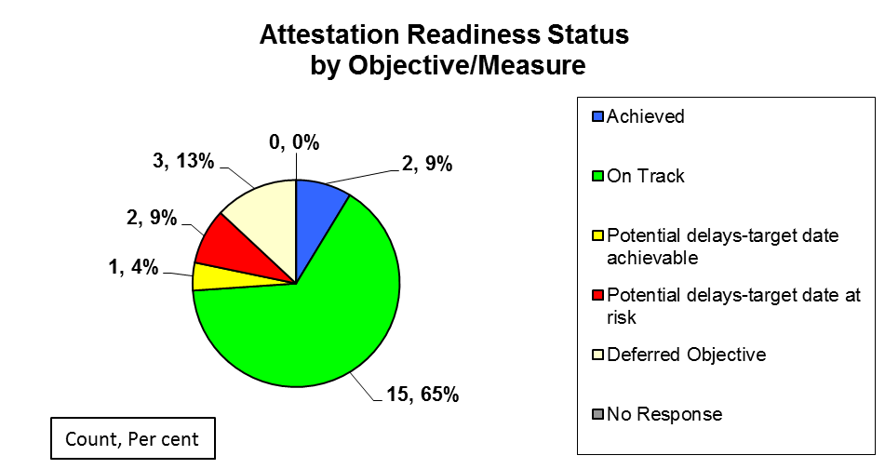
Meaningful Dashboard as of Today
We’re getting closer, but 3 measures still at risk…
Blue: PHA Reporting – Syndromic Surveillance & Immunization “live” via ConnectVirginia (Va. HIE = exclusive “transport option”)
Green: Automated Measures, e.g. CPOE; Family History and Education, PHA (Lab)
Yellow: CQMs (mapping and process design…after attestation period start date)
Red: VoDT (Patient Portal); Summary of Care

Slide 12
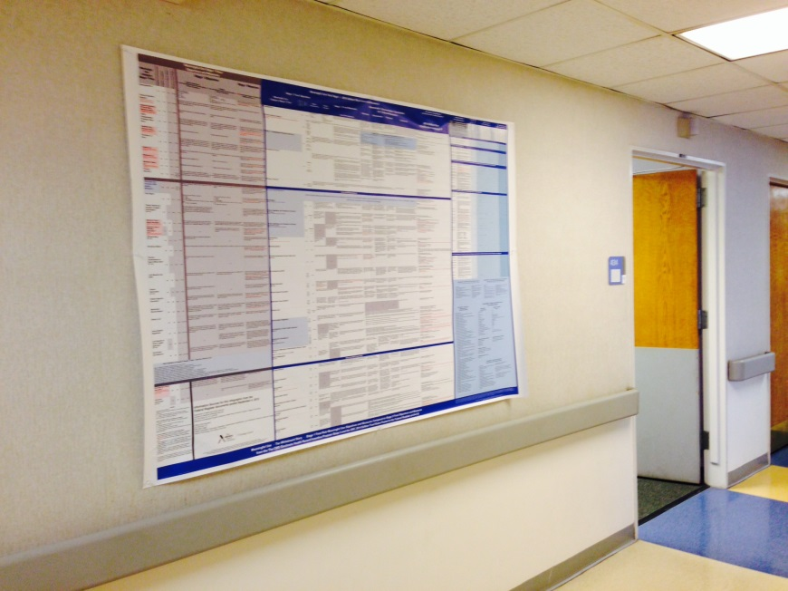
And we thought we were ready, but…
Blurry lines
  Ambiguity: CMS Measure descriptions, FAQs, webinars
  Vendor / Industry Interpretation: Proverbial square peg in round hole
  Is there a source of truth or subject matter expert out there?
    Ongoing engagement with third party consultants for validation
    Next to no MU-2 Audit results or experiential data
(Seemingly) Never ending implementation
  Still deploying hot fixes and service packs
  Still tweaking processes
Ongoing challenges
  Attaining last three measures
  Sustaining measures
MU-2 Whiteboard Story, aka the
“Wall of Discouraging Enlightenment”

Slide 13
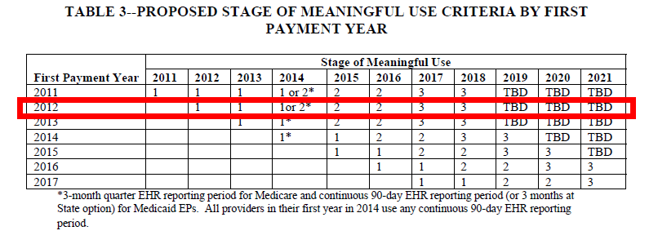
What if we don’t make it? A Lifeline?
NPRM (Federal Register May 23, 2014) offers option for hospitals unable to get all Electronic Health Record (EHR) 2014-certified software fully deployed
If enacted (~ August 2014?):
  Would allow us attest to Stage 1 measures for 2014 quarter
  Much better than Hardship because we’d get 2014 EHR incentive payment
  Buys us (just) another 90 days. Still must meet MU-2 beginning 10/01/2014
Just in case: VHC is maintaining Stage 2 and Stage 1 metrics effective July 1
VHC represented in red box
Notes:
60-day comment period ends ~July 23, 2014

Slide 14


Which do you prefer?
Meaningful Use
Dental Work

